Slide 1

Decept of Home
Team Name : Roboduino 4
Team Members :
Avneesh Sahu 20224039 ECE
Manudev Verma 20226082 ME​
Pramod Biradar 20224046 ECE
Duvvu Sai Komal 20224063 ECE

Slide 2
HOME AUTOMATION
Home automation is the process of automating household tasks and functions using technology.
This include everything from controlling your lights and doors with a smartphone app, to getting your temperature, humidity and gas/smoke data onto your phone.
The goal of home automation is to make life easier and more convenient for homeowners.
By automating repetitive tasks, homeowners can save time and energy, and enjoy a more comfortable and efficient living environment.

Slide 3
Features
Security
Smart Sense
Internet of Things
Servers

Slide 4

security
rfid
Laser security
Password based
Locking system
Barcode scanner

Slide 5
RFID
RFID(Radio Frequency Identification) can be used in security . It opens the door only when it detects a unique tag.
Laser security
If ldr sensor does not sense the laser which falls on it after reflections due to mirror then buzzer is turned on.
Password based locking system
App can be accessed by entering the correct password in the app made by Mit App inventor.
Barcode scanner security
By scanning the barcode on the card ,we can access the app made by mit app inventor and we can control devices and door through it. .

Slide 6
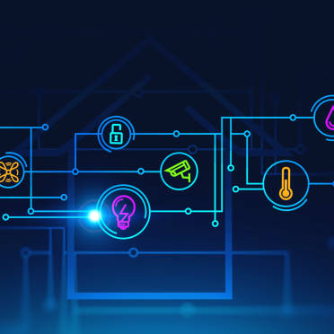
Smartsense
Soil moisture
ldr
garage
Stairs

Slide 7
Soil moisture
Soil moisture detects the moisture content in the soil. If it goes above a certain level then it turns the water pump on. When moisture content restores back to its value then water pump stops automatically.
LDR
LDR sensor senses the intensity of light. If it reads above a certain value then the lights will turn on.
garage
The ultrasonic sensor detects the vehicle coming towards it and opens the door for the vehicle to move in.
stairs
The ultrasonic sensor detects if a person is walking up/down the stairs
and turns on the lights . This prevents the person to stumble.

Slide 8

Internet of things
unidirectional
visitor counter
Controlling fan
Controlling light
and its brightness
Controlling lights
using google
assistant

Slide 9
biDIRECTIONAL VISITOR COUNTER
Unidirectional visitor counter counts the number of persons entering the room .This count will be displayed in the blynk app.
CONTROLLING FAN
Fan’s speed and power can be controlled by blynk app . App made by mit app inventor can also control the power of the fan.
CONTROLLING LIGHTS AND ITS BRIGHTNESS
The power of lights and brightness can be controlled by blynk app. Fan can be switched on and off using app made by mit app inventor.
CONTROLLING LIGHTS USING GOOGLE ASSISTANT
Lights can also be controlled by google assistant through blynk app.
l

Slide 10
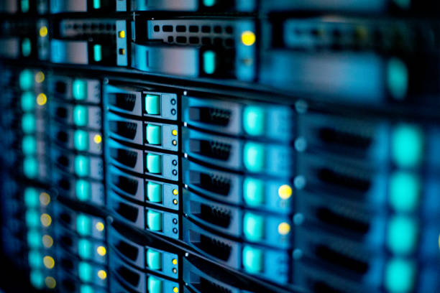
server
thingspeak
Blynk app and
webconsole
Arduino iot

Slide 11
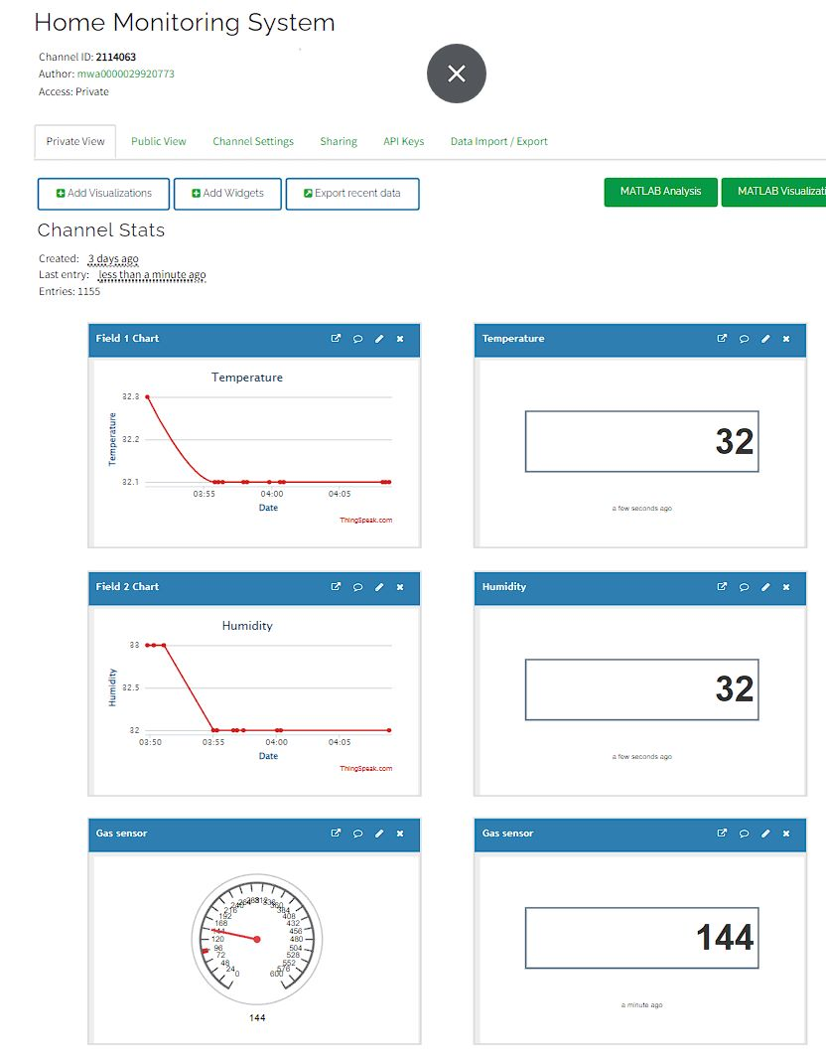
thingspeak
ThingSpeak is an (IoT) analytics platform that allows users to collect, store, analyze, visualize, and act on data from sensors.
We are sending temperature, humidity and gas sensor values to thingspeak server and plotting it against time.

Slide 12
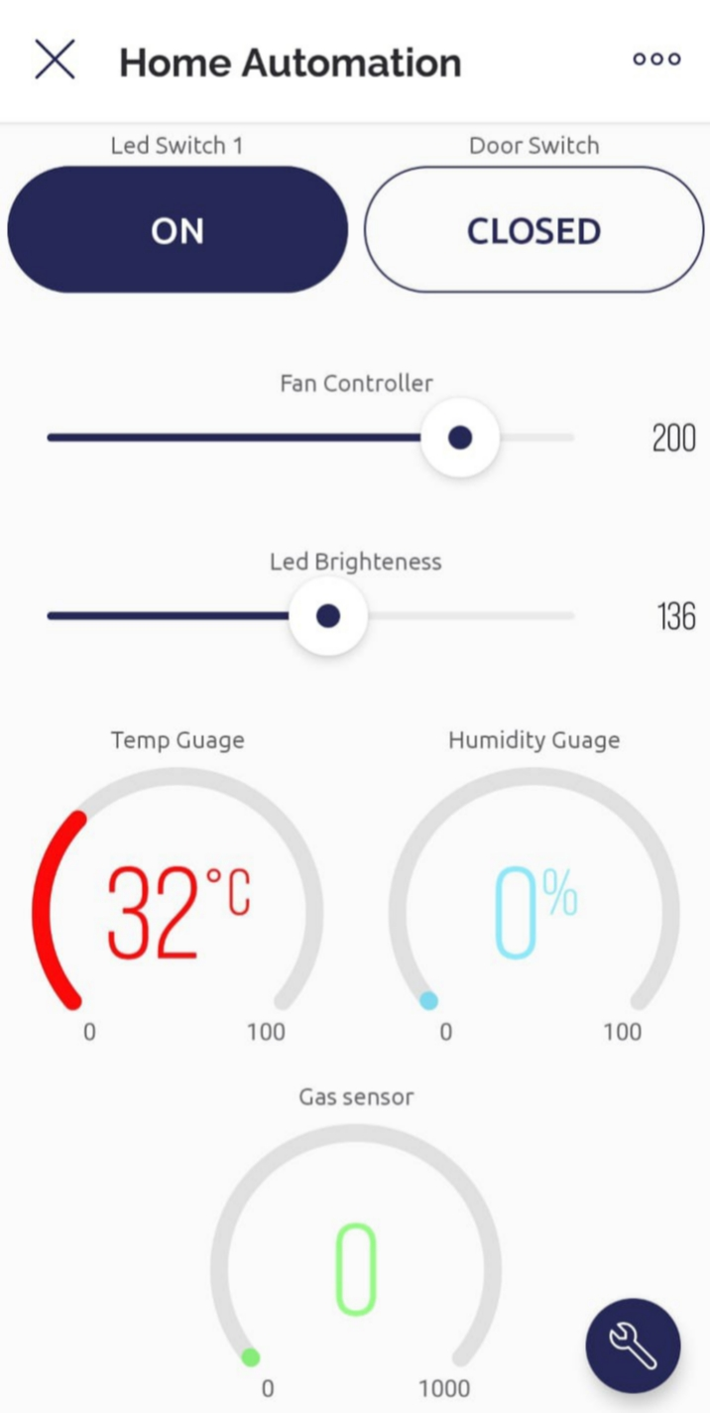
Blynk app
Blynk is a mobile app that allows you to easily control and monitor your Internet of Things (IoT) devices using a smartphone or tablet.
We are controlling door, fan speed, light and its brightness through this. And monitoring temperature, humidity and gas sensor values.
We are also able to monitor the number of persons entering, exiting and present in the home.

Slide 13
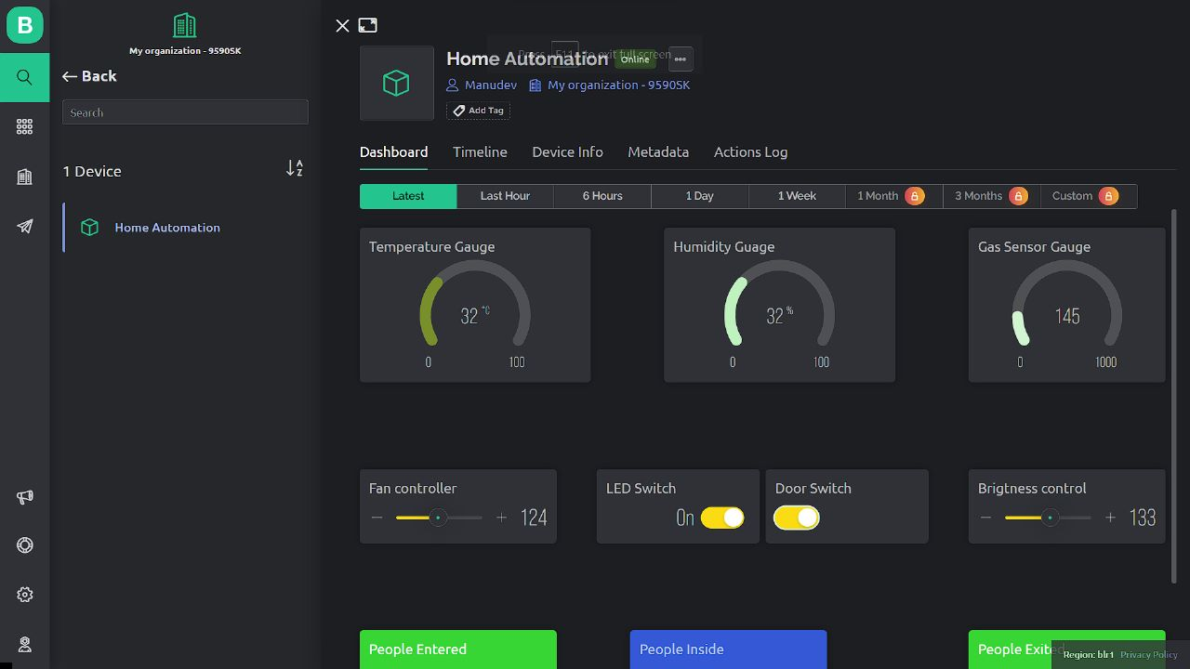
Blynk webconsole
Blynk webconsole is a feature rich web application that can be used by different type of users. The key functionality of this product is:
Configuration of how connected devices work on the platform .
Monitoring of devices in a web browser.
Management of devices,users,and locations.

Slide 14
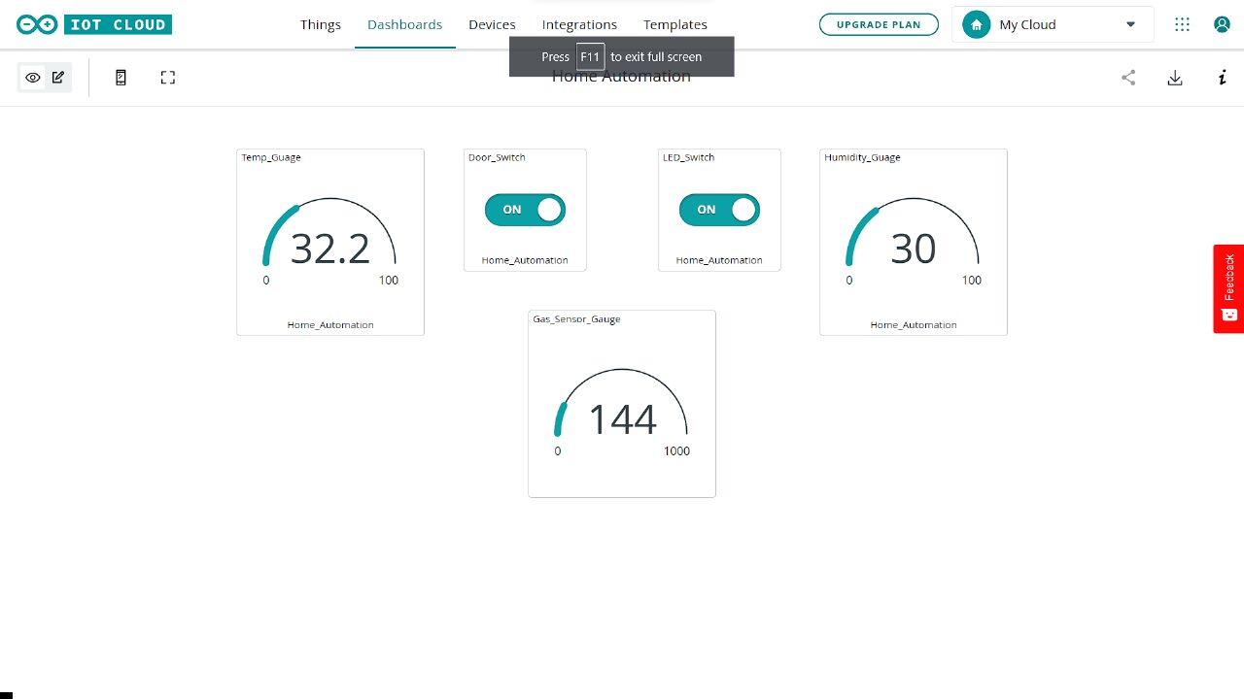
Arduino iot
Arduino IoT is a platform that allows you to connect your Arduino boards with the internet, enabling you to build IoT (Internet of Things) applications.
Controlling light and door can be done.
Monitoring temperature, humidity and gas sensor values.

Slide 15

Thank you

